Slide 1
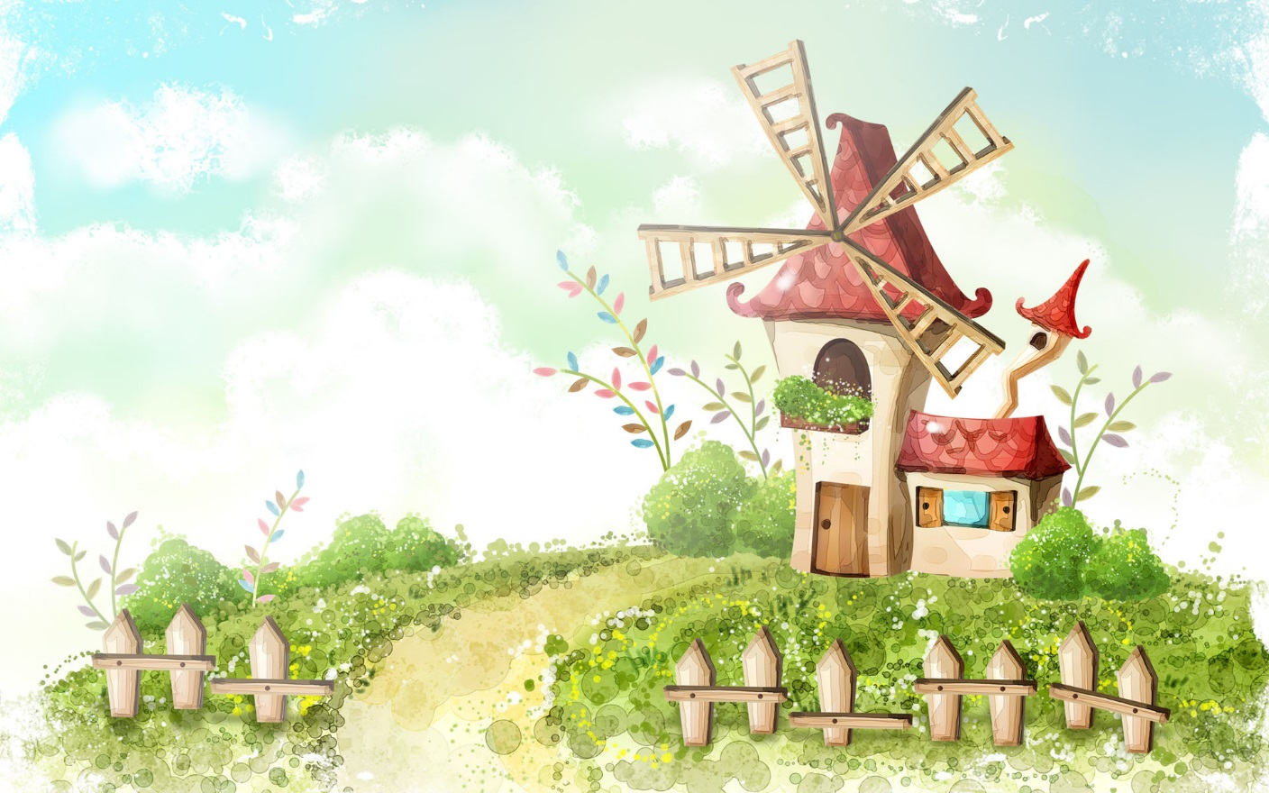
Hello every one !!!

Slide 2

* WARM-UP
Game: Face to face
* List the words related to “Traditional performances”
TRADITIONAL PERFORMANCES
water puppet show

Slide 3
TRADITIONAL PERFORMANCES
water puppet show
- Quan Ho singing,
- Xoan singing,
Ca Tru singing, Nha nhac,
Don Ca Tai Tu,
- Bai Choi Folk Singing,
- Cultural Space of Gong,
- A O show,
-…………

Slide 4



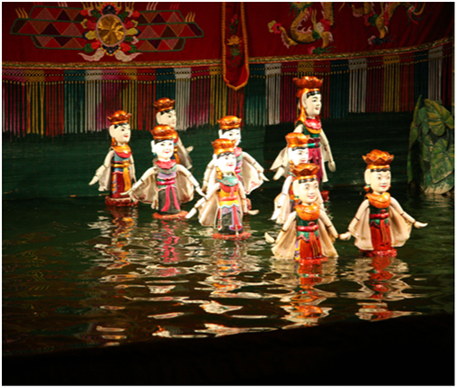
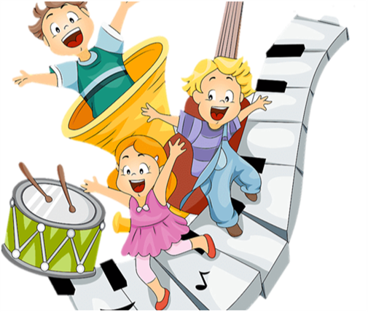
Unit
4
MUSIC AND ARTS
LESSON 5: SKILLS 1
READING
SPEAKING
Unit

Slide 5
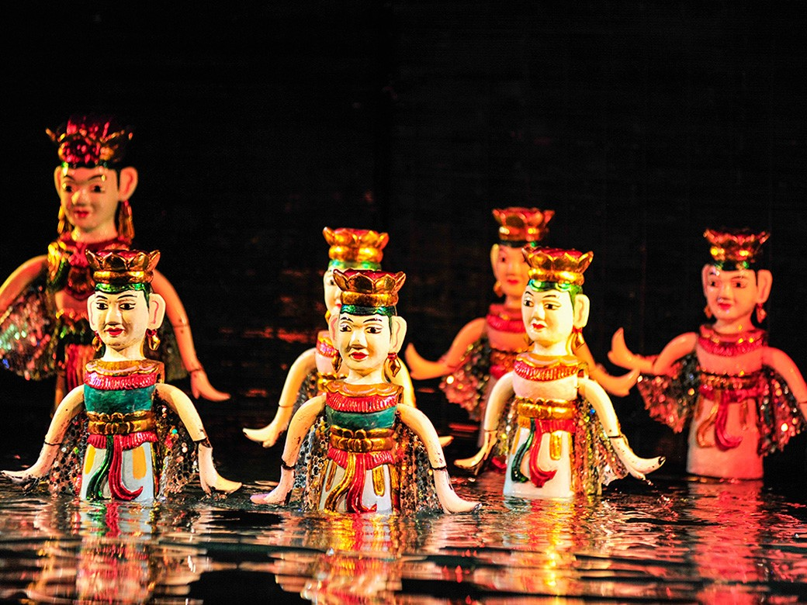
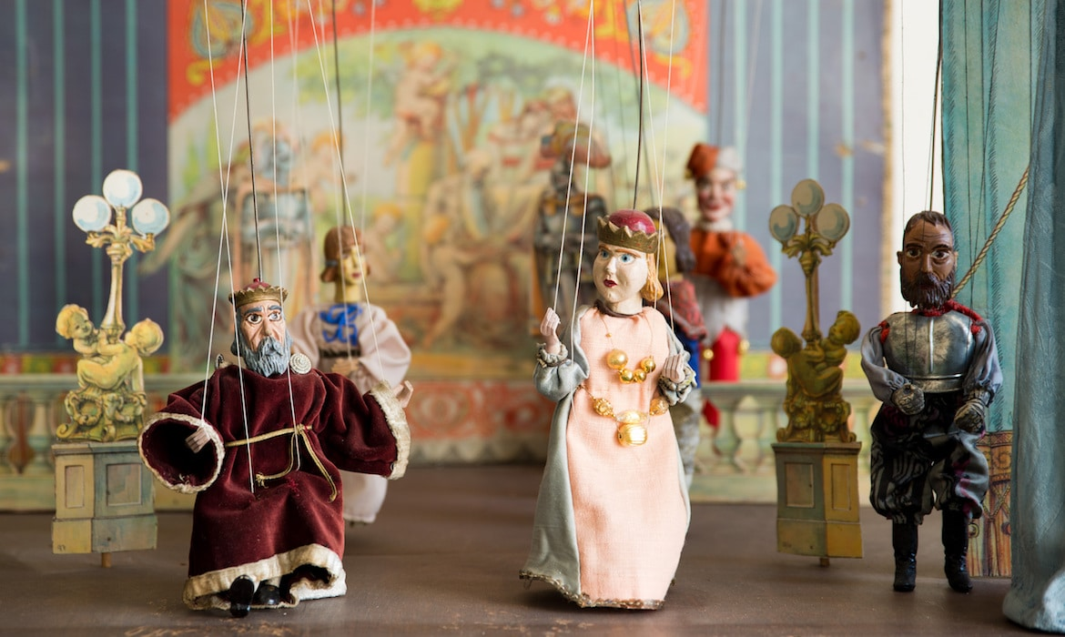
* VOCABULARY
- puppetry (n) :
nghệ thuật múa rối
/ˈpʌpɪtri/

Slide 6
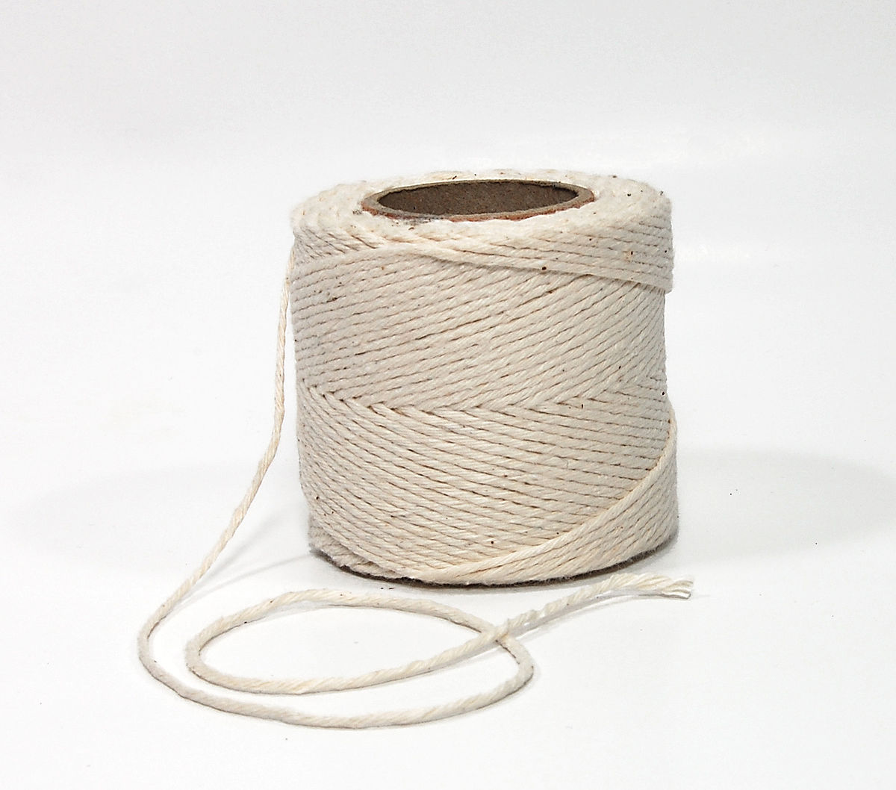
- string (n):
sợi dây
/strɪŋ/

Slide 7
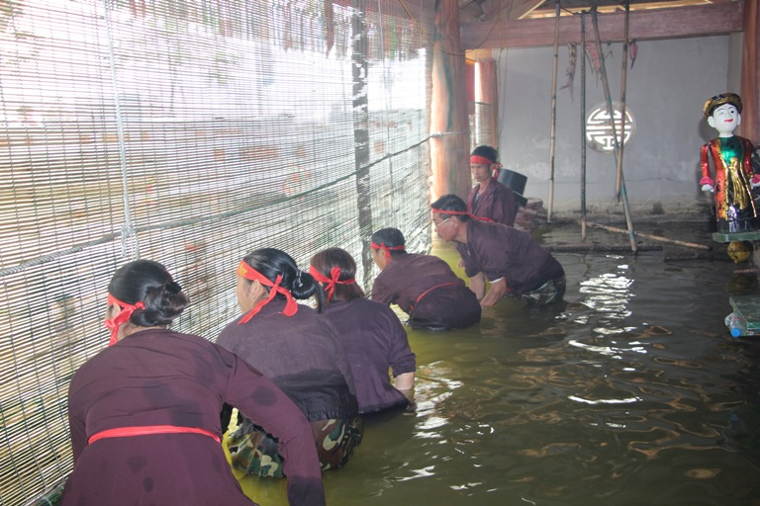
- control (v):
/kənˈtrəʊl/
kiểm soát, điều khiển

Slide 8
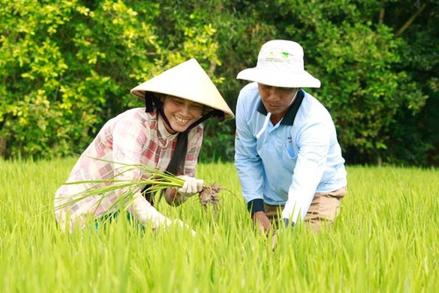
- rice farming (n. phr):
/raɪs ˈfɑːmɪŋ/
trồng lúa

Slide 9
* VOCABULARY
New words | Pronunciation | Meaning
- puppetry (n) | /ˈpʌpɪtri/ | nghệ thuật múa rối
- string (n) | /strɪŋ/ | sợi dây
- control (v) | /kənˈtrəʊl/ | kiểm soát, điều khiển
- rice farming | /raɪs ˈfɑːmɪŋ/ | trồng lúa

Slide 10
* Checking vocabulary:
New words | Meaning
 | nghệ thuật múa rối
 | sợi dây
 | kiểm soát, điều khiển
 | trồng lúa
- puppetry (n)
- string (n)
- control (v)
- rice farming (n.phr)

Slide 11

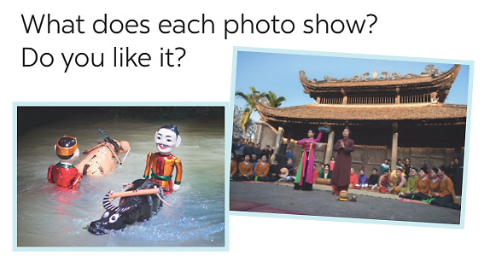
I. READING
1. Look at the pictures. Discuss the questions below with a partner.
1/ - The first picture shows a water puppet show.
- The second picture is the Quan Ho singing.
2/ Yes/ No …….

Slide 12

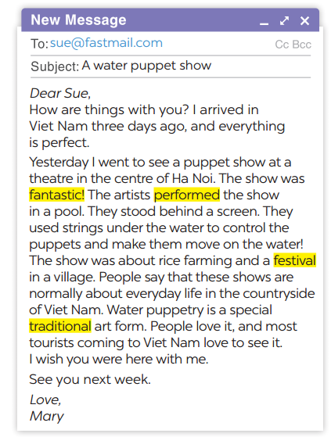
1
Read the email and match the highlighted words with their meanings.
1. showed or presented
2. following tradition
3. nice, interesting
4. event or celebration
→ performed
→ traditional
→ fantastic
→ festival

Slide 13
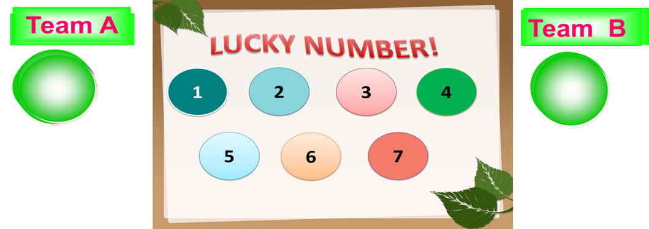
3
Read the email again and answer the questions.
1. Who went to see a water puppet show yesterday?
2. Where did the artists perform the show?
3. Who controlled the puppets?
4. What are water puppet shows normally about?
5. Is water puppetry a traditional Vietnamese art form?
Notes:
Lucky numbers: 1,4,8
Number 2: Question 1
Number 3: Question 2
Number 5: Question 3
Number 6: Question 4
Number 7: Question 5

Slide 14

LUCKY NUMBER!
1
2
3
4
5
6
7
8

Slide 15
1. Who went to see a water puppet show yesterday?
→ Mary did.

Slide 16
2. Where did the artists perform the show?
→ In a pool.

Slide 17
3. Who controlled the puppets?
→The artists did.

Slide 18
4. What are water puppet shows normally about?
→About everyday life in the countryside of Viet Nam.

Slide 19
5. Is water puppetry a traditional Vietnamese art form?
→ Yes, it is.

Slide 20

LUCKY NUMBER!
you get 2 plus points

Slide 21
LUCKY NUMBER!
you get 2 plus points

Slide 22
LUCKY NUMBER!
you get 2 plus points

Slide 23
3
Read the email again and answer the questions.
1. Who went to see a water puppet show yesterday?
2. Where did the artists perform the show?
3. Who controlled the puppets?
4. What are water puppet shows normally about?
5. Is water puppetry a traditional Vietnamese art form?
→ Mary did.
→In a pool.
→The artists did.
→About everyday life in the countryside of Viet Nam.
→ Yes, it is.

Slide 24
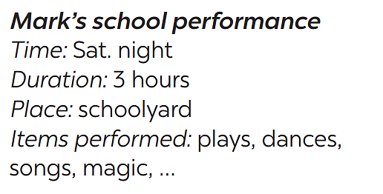

II. SPEAKING
4
Ask and answer about Mark’s school musical performance last year.
A:
B:
A:
B:
When was the performance?
On Saturday night.
How long did it last?
It lasted three hours.

Slide 25
II. SPEAKING
4
Ask and answer about Mark’s school musical performance last year.
A:
B:
A:
B:
Where did it take place?
In the schoolyard.
What did they perform?
They performed some plays, danced, sang songs, .

Slide 26

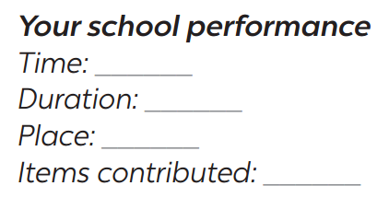
5
Make a plan for the performance and talk about the items you will contribute.
Your school is going to have a musical performance to celebrate Teachers’ Day.

Slide 27
5
Make a plan for the performance and talk about the items you will contribute.
Your school is going to have a musical performance to celebrate Teachers’ Day.
Your school performance
- Time: 8 p.m
- Duration: 3 hours
- Place: school stage
- Items contributed: songs, dramas, dances,…

Slide 28
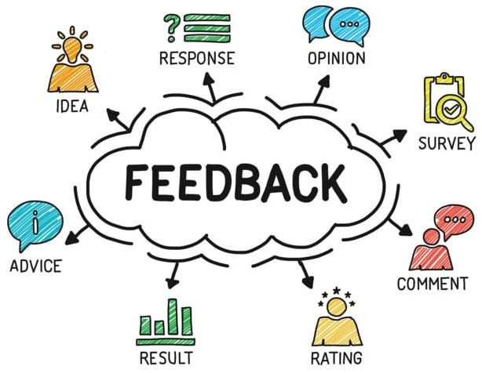
* PRODUCTION
What do you think about your plan for
a school musical performance?

Slide 29
* CONSOLIDATION
READING
SPEAKING

Slide 30

* HOMEWORK
Do exercises in the workbook.
Prepare for the next lesson: Skills 2.

Slide 31


Thank you!
Goodbye!

Slide 32

2
Read the passage again and decide these statements are True or False.
Statements | True | False
1. Mary went to see a puppet show in an art museum in the centre of Ha Noi.
2. The show was presented by the artists stood behind a screen in a pool.
3. These shows are normally about everyday life in the countryside and in the city of Viet Nam.
4. Tourists come to Viet Nam love to see it because it is a special traditional art form.

